Slide 1


SWE111
Cyclometric Complexity
Instructor:
Nusrat jahan
Lecturer, SWE, DIU.

Slide 2
Software Testing

Slide 3
Software Testing
helps to reduce the risk of problem occurring

Slide 4
Error, Fault and Failure
A programmer makes an error (mistake)
Error results in a defect (fault, bug) in the software source code
A failure occurs when a faulty piece of code is executed.

Slide 5
V & V
Validation: Are we building the right product?’
Verification: Are we building the product right?’

Slide 6
V & V
The aim of verification is to check that the software meets its stated functional and non-functional requirements.
The aim of validation is to ensure that the software meets the customer’s expectations.

Slide 7
Testing Vs Debugging
Debugging: The process of finding, analyzing and removing the causes of failure.
Testing: is a quality assurance activities.

Slide 8
Test Types
Functional Testing
Non-functional testing

Slide 9
Functional Vs Non-functional testing

Slide 10
Functional testing
Functional testing refers to tests that verify a specific action or function of the code.
These are usually found in the code requirements documentation, although some development methodologies work from use cases or user stories.
Functional tests tend to answer the question of "can the user do this" or "does this particular feature work".

Slide 11
Non-functional testing
Non-functional testing refers to aspects of the software that may not be related to a specific function or user action, such as scalability or security.
Non-functional testing tends to answer such questions as "how many people can log in at once", or "how easy is it to hack this software".

Slide 12
Static Vs Dynamic

Slide 13
Black Box Testing
Specification Based

Slide 14
White Box Testing
Structured Based Testing

Slide 15
Gray Box Testing
Black Box testing + White Box Testing

Slide 16
Test Levels
Unit / Component Testing
Integration Testing
System Testing
Acceptance Testing
Alpha and Beta (field) testing

Slide 17
Testing Techniques

Slide 18
White-Box Testing
Glass-box testing
Structural testing

Slide 19
White-Box Testing
Guarantee that all independent paths within a module have been exercised at least once
Exercise all logical decisions on their true and false sides
Execute al loops at their boundaries and within their operations bounds
Exercise internal data structures to ensure their validity

Slide 20
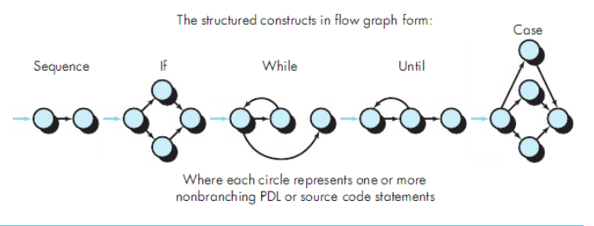
Basic Path Testing
White-box testing techniques
Flow graph (or Program Graph) Notation
A simple notation for the representation of control flow

Slide 21
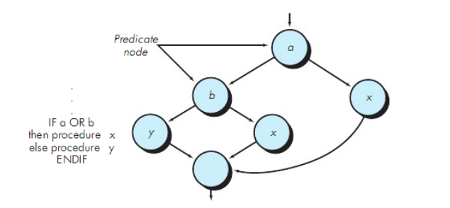
Basic Path Testing
A node containing a condition is called a predicate node.

Slide 22
How many paths we need to test?

Slide 23
Cyclomatic Complexity
Is a software metric that provides a quantitative measure of the logical complexity of a program.
It defines the number of independent paths in the basic set of a program.

Slide 24
Cyclomatic Complexity
Complexity is computed in one of three ways:
The number of regions of the flow graph corresponds to the cyclomatic complexity
Cyclomatic complexity V(G) for a flow graph G is defined as
V(G) = E – N + 2, where E is the number of flow graph edges and N is the number of flow graph nodes.
Cyclomatic complexity V(G) for a flow graph G is defined as
V(G) = P + 1, where P is the number of predicate nodes.

Slide 25
Graph Matrices
Is a data structure that assists in basic path testing.
It is a square matrix whose size is equal to the number of nodes on the flow graph

Slide 26
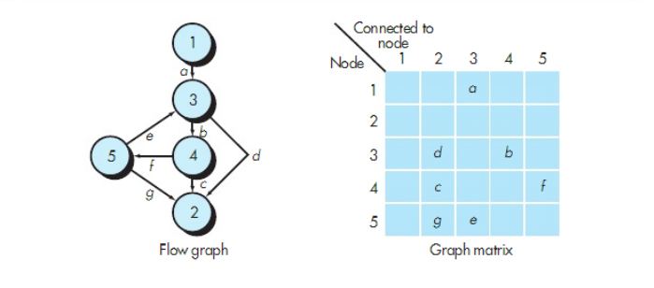
Graph Matrices

Slide 27
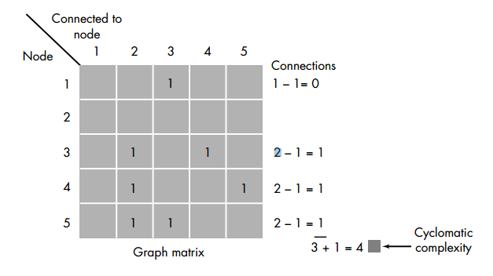
Connection matrix

Slide 28
Black Box testing
Black box testing is testing that ignores the internal mechanism of a system or component and focuses only on the outputs generated in response to selected inputs and execution conditions.

Slide 29
Boundary Value analysis
A test design that focus on finding range related errors
Test cases for input box accepting numbers between 1 and 1000 using Boundary value analysis: -Test cases with test data exactly as the input boundaries of input domain i.e. values 1 and 1000 in our case.
-Test data with values just below the extreme edges of input domains i.e. values 0 and 999.
- Test data with values just above the extreme edges of input domain i.e. values 2 and 1001.

Slide 30
Equivalence partitioning
Equivalence partitioning (also called Equivalence Class Partitioning or ECP) is a software testing technique that divides the input data of a software unit into partitions of equivalent data from which test cases can be derived. In principle, test cases are designed to cover each partition at least once. This technique tries to define test cases that uncover classes of errors, thereby reducing the total number of test cases that must be developed. An advantage of this approach is reduction in the time required for testing a software due to lesser number of test cases.

Slide 31
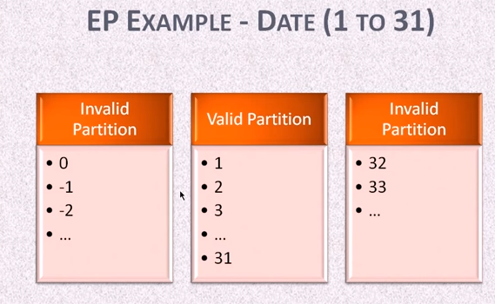

Slide 32
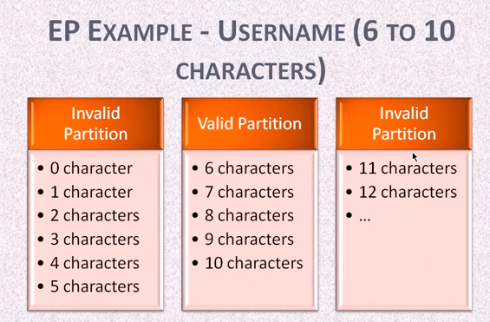

Slide 33

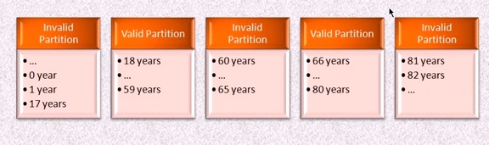

Slide 34
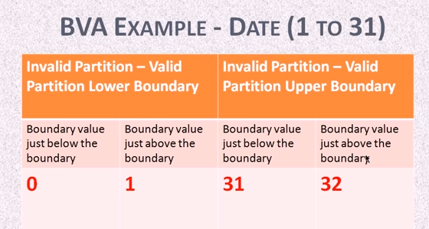

Slide 35
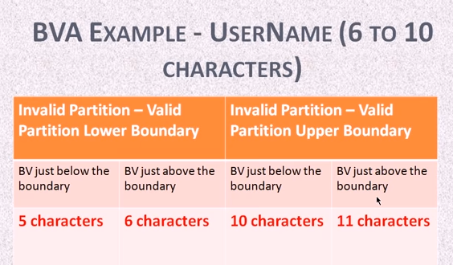

Slide 36
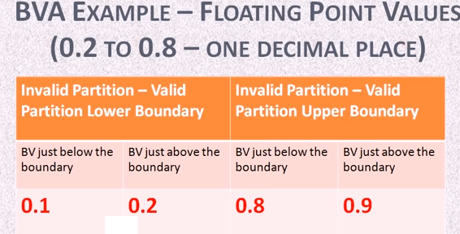

Slide 37
Decision Table
Document the complicated logic
Help to test all combinations of conditions
Contains condition and action

Slide 38
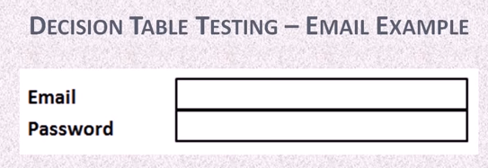
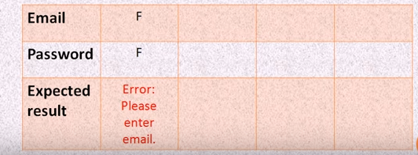

Slide 39
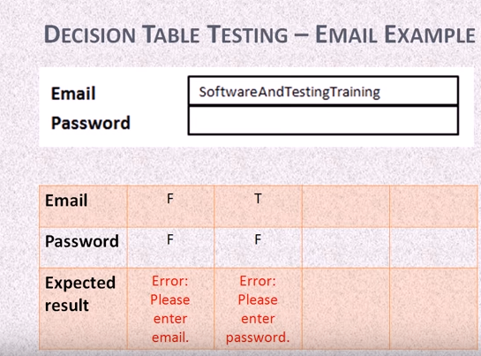

Slide 40
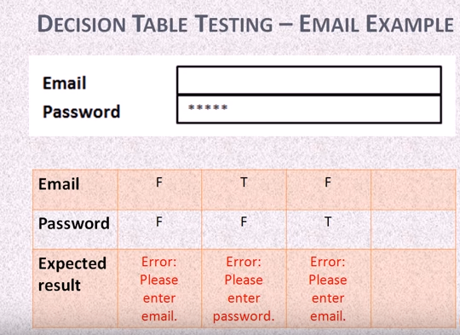

Slide 41
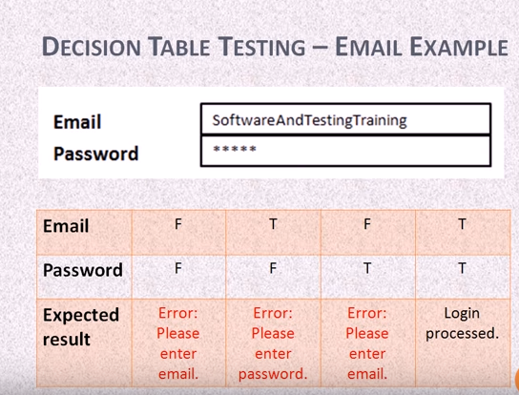

Slide 42
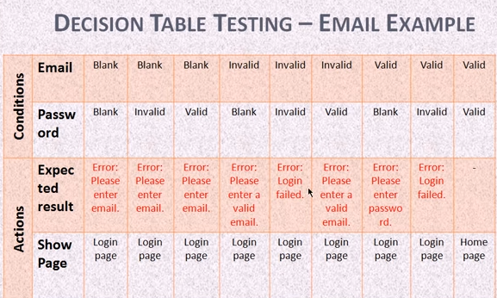

Slide 43
